Slide 1
AI in Agriculture
General Applications of AI
Focus on Crop Monitoring & Prediction, and Drone Vision

Slide 2
Outline
Introduction to AI in Agriculture
AI-based Solutions for Agriculture
Remote Sensing & NDVI
AI + Drone Vision Use Cases
Hands-On / Demo

Slide 3
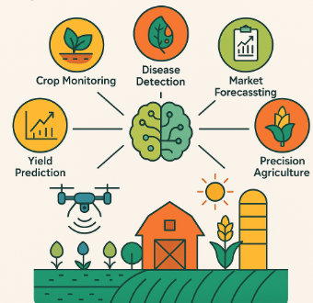
Introduction to AI in Agriculture
Artificial Intelligence (AI) in agriculture refers to the use of smart algorithms, machine learning models, and data-driven technologies to optimize various aspects of farming.
It enables precision, prediction, and automation across the agricultural value chain.

Slide 4
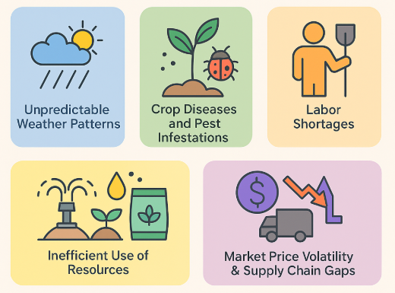
Introduction to AI in Agriculture
Key Challenges in Agriculture
Modern agriculture faces several critical issues:
Unpredictable weather patterns due to climate change
Pest infestations and plant diseases leading to yield loss
Water scarcity and inefficient irrigation
Declining soil health from over-farming or improper fertilization
Labor shortages and reliance on manual methods
Lack of timely information on market pricing and logistics

Slide 5
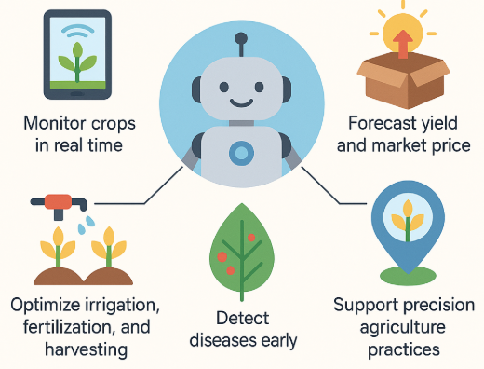
Introduction to AI in Agriculture
Why AI?
Artificial Intelligence brings automation, prediction, and decision-making capabilities into agriculture, helping:
Monitor crops in real time
Optimize irrigation, fertilization, and harvesting
Detect diseases early
Forecast yield and market price
Support precision agriculture practices

Slide 6
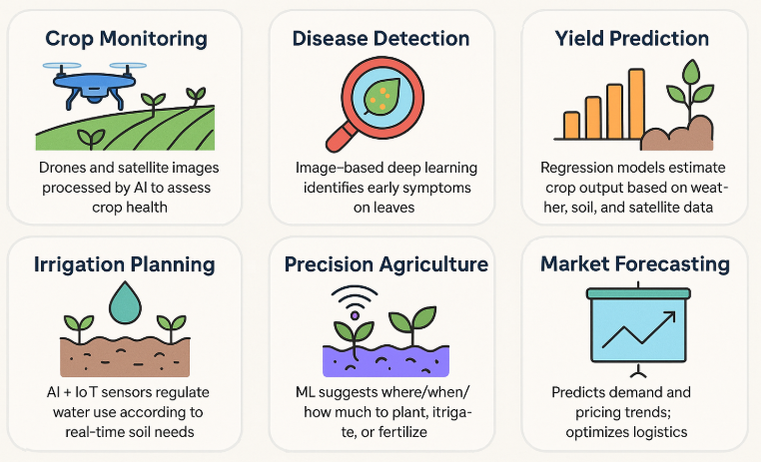
Introduction to AI in Agriculture
Key Applications of AI
Crop Monitoring: Drones and satellite images processed by AI to assess crop health.
Disease Detection: Image-based deep learning identifies early symptoms on leaves.
Yield Prediction: Regression models estimate crop output based on weather, soil, and satellite data.
Irrigation Planning: AI + IoT sensors regulate water use according to real-time soil needs.
Precision Agriculture: ML suggests where/when/how much to plant, irrigate, or fertilize.
Market Forecasting: Predicts demand and pricing trends; optimizes logistics.

Slide 7
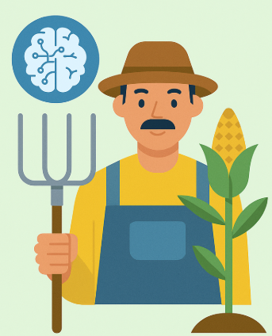
Introduction to AI in Agriculture
Impact
AI empowers farmers—especially in developing countries—with tools for:
Better decision-making
Reduced input costs
Increased productivity
Sustainable resource use

Slide 8
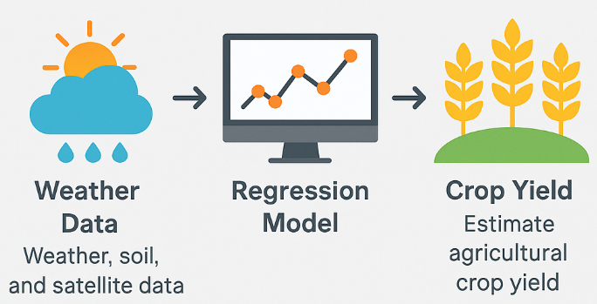
AI-based Solutions
Yield Prediction:
Regression models trained on weather, soil, and satellite data
Regression models use environmental and remote sensing data to estimate agricultural crop yield with reasonable accuracy.
What Is Yield Prediction?
Crop yield is the amount of crop produced per unit area (e.g., kg/hectare).
Predicting yield helps farmers, governments, and supply chains plan harvesting, storage, logistics, and pricing.

Slide 9
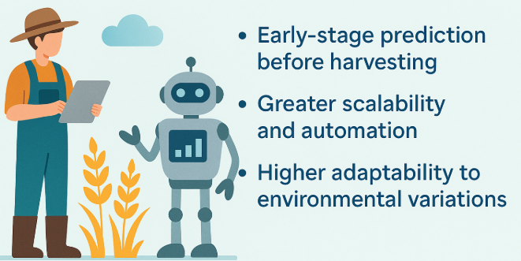
AI-based Solutions
Yield Prediction:
Why Use AI for Yield Prediction?
Traditional methods rely on ground surveys. AI enables:
Early-stage prediction before harvesting
Greater scalability and automation
Higher adaptability to environmental variations

Slide 10
AI-based Solutions
Yield Prediction: Inputs to the Model
Data Source | Features
Weather | Temperature, Rainfall, Humidity, Wind Speed
Soil | Moisture, Nitrogen/Phosphorus/Potassium (NPK), pH
Satellite | NDVI, EVI, LAI (Leaf Area Index), LST (Land Surface Temperature)
Farmer Input (optional) | Sowing date, seed variety, fertilizer use

Slide 11
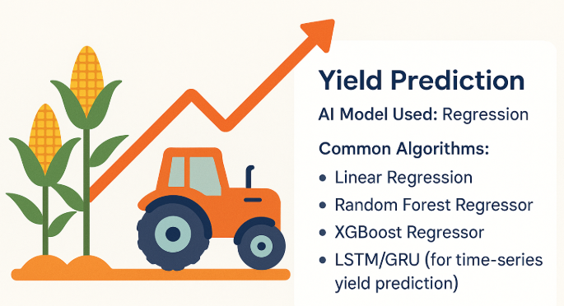
AI-based Solutions
Yield Prediction: AI Model Used: Regression
Common Algorithms:
Linear Regression
Random Forest Regressor
XGBoost Regressor
LSTM/GRU (for time-series yield prediction)

Slide 12
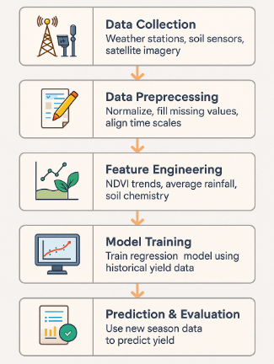
AI-based Solutions
Yield Prediction: Model Workflow
Data Collection → Weather stations, soil sensors, satellite imagery
Data Preprocessing → Normalize, fill missing values, align time scales
Feature Engineering → NDVI trends, average rainfall, soil chemistry
Model Training → Train regression model using historical yield data
Prediction & Evaluation → Use new season data to predict yield

Slide 13
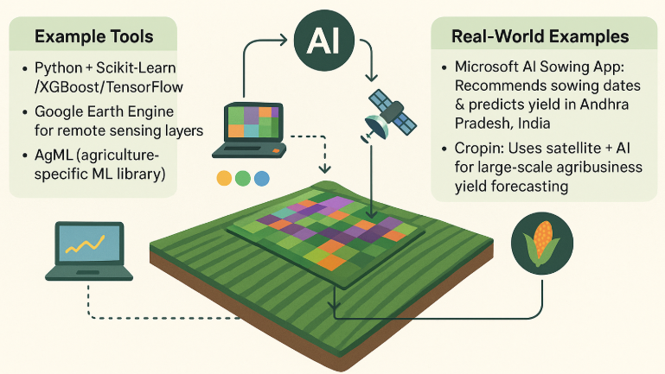
AI-based Solutions
Yield Prediction:
Example Tools
Python + Scikit-Learn / XGBoost / TensorFlow
Google Earth Engine for remote sensing layers
AgML (agriculture-specific ML library)
Real-World Examples
Microsoft AI Sowing App: Recommends sowing dates & predicts yield in Andhra Pradesh, India.
CropIn: Uses satellite + weather + AI for large-scale agribusiness yield forecasting.

Slide 14
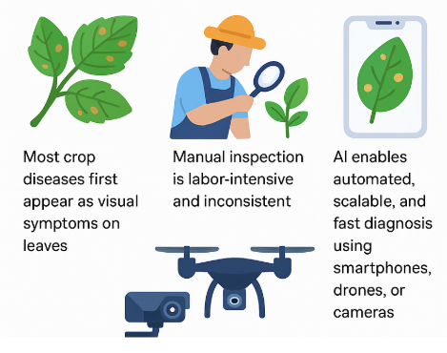
AI-based Solutions
Disease Detection:
Image-based deep learning models classify leaf diseases
Deep learning can classify plant diseases by analyzing leaf images, helping farmers take early corrective action.
Why Image-Based Disease Detection?
Most crop diseases first appear as visual symptoms on leaves.
Manual inspection is labor-intensive and inconsistent.
AI enables automated, scalable, and fast diagnosis using smartphones, drones, or cameras.

Slide 15
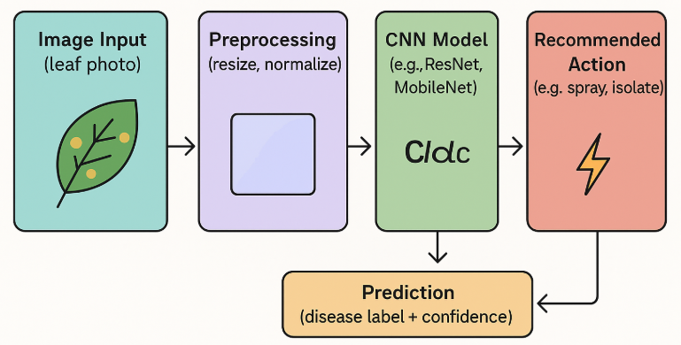
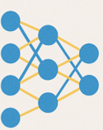
AI-based Solutions
Disease Detection
How It Works: Step-by-Step Pipeline
Image Input (leaf photo)
Preprocessing (resize, normalize)
CNN Model (e.g., ResNet, MobileNet)
Prediction (disease label + confidence)
Recommended Action (e.g., spray, isolate)

Slide 16
AI-based Solutions
Disease Detection
Popular Datasets
PlantVillage Dataset: 50,000+ labeled images across 38 crop-disease classes (e.g., tomato, potato, apple)
Kaggle Competitions: Rice leaf disease, cassava disease, cotton disease, etc.
Common Deep Learning Models
Model | Why It’s Used
CNN (Convolutional Neural Network) | Captures patterns like spots, discoloration, texture
MobileNet / EfficientNet | Lightweight models for edge deployment (e.g., smartphones/drones)
ResNet | Deep, powerful model with high accuracy

Slide 17
AI-based Solutions
Disease Detection
Example Classes (from PlantVillage)
.
Class | Symptom
Apple – Scab | Dark lesions on leaves
Tomato – Bacterial Spot | Water-soaked spots that enlarge
Potato – Early Blight | Dark brown spots with concentric rings

Slide 18
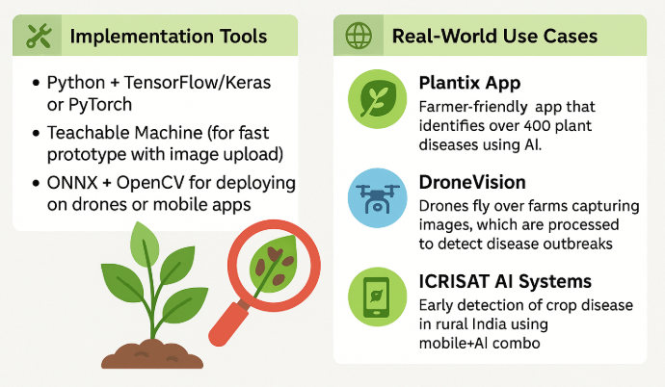
AI-based Solutions
Disease Detection
Implementation Tools
Python + TensorFlow/Keras or PyTorch
Teachable Machine (for fast prototype with image upload)
ONNX + OpenCV for deploying on drones or mobile apps
Real-World Use Cases
Plantix App: Farmer-friendly app that identifies over 400 plant diseases using AI.
DroneVision: Drones fly over farms capturing images, which are processed to detect disease outbreaks.
ICRISAT AI Systems: Early detection of crop disease in rural India using mobile+AI combo

Slide 19
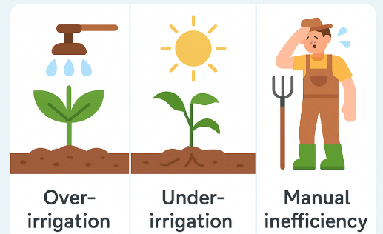
AI-based Solutions
Irrigation Planning
AI + IoT sensors optimize water usage based on crop/soil needs
Artificial intelligence, when combined with IoT sensors, enables precise and efficient irrigation based on real-time crop and soil conditions.
Why Smart Irrigation Matters
Traditional irrigation methods (e.g., fixed scheduling or flood irrigation) result in:
Over-irrigation → Wasted water, soil nutrient depletion, fungal growth
Under-irrigation → Crop stress, reduced yield
Manual inefficiency → Labor-intensive monitoring

Slide 20
AI-based Solutions
Irrigation Planning
IoT Sensor Network: Key sensors deployed in the field:
Sensor Type | Function
Soil Moisture Sensor | Measures volumetric water content in soil
Temperature/Humidity Sensor | Tracks environmental influence on evapotranspiration
pH and EC Sensors | Monitors chemical quality of irrigation water
Rainfall Sensor | Adjusts watering schedules based on precipitation
Flow Meters | Tracks irrigation quantity and detects leakages

Slide 21
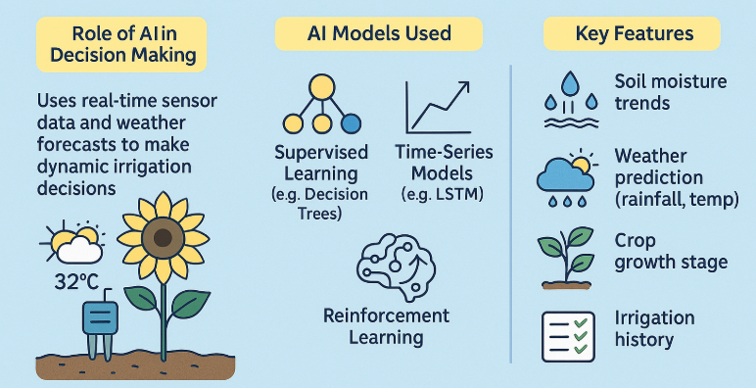
AI-based Solutions
Irrigation Planning
AI uses real-time sensor data and weather forecasts to make dynamic irrigation decisions.
AI Models Used:
Supervised Learning (e.g., Decision Trees, SVM): Learn optimal moisture thresholds.
Time-Series Models (e.g., LSTM): Predict future soil moisture from historical patterns.
Reinforcement Learning: Adaptive irrigation based on maximizing crop yield/reducing water use over time.
Key Features:
Soil moisture trends, Crop evapotranspiration (ET₀)
Weather prediction (rainfall, temp), Crop growth stage, and Irrigation history

Slide 22
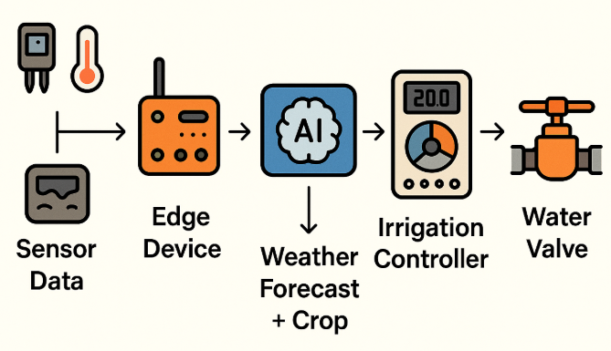
AI-based Solutions
Irrigation Planning
Edge Device: Arduino, Raspberry Pi, or ESP32 gathers data.
AI Model: Runs locally or in the cloud to make irrigation decisions.
Actuator: Solenoid valve or pump turns on/off based on AI output.
Workflow: End-to-End System

Slide 23
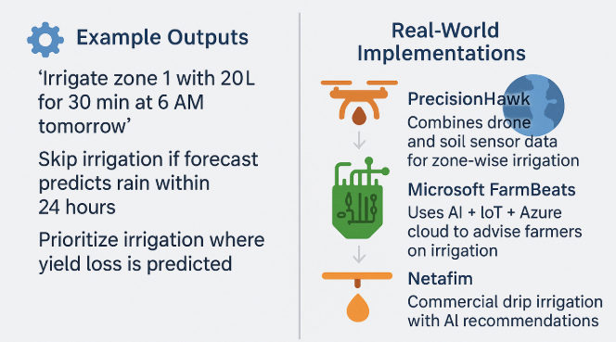
AI-based Solutions
Irrigation Planning
Example Outputs
"Irrigate zone 1 with 20L for 30 min at 6 AM tomorrow"
Skip irrigation if forecast predicts rain within 24 hours
Prioritize irrigation where yield loss is predicted
Real-World Implementations
PrecisionHawk: Combines drone and soil sensor data for zone-wise irrigation.
Microsoft FarmBeats: Uses AI + IoT + Azure cloud to advise farmers on irrigation.
Netafim: Commercial drip irrigation with AI recommendations.

Slide 24
AI-based Solutions
Crop Monitoring
Drones capture multispectral images; AI analyzes crop health
AI-Powered Crop Monitoring: How drones collect multispectral imagery and AI models analyze that data to monitor and optimize crop health throughout the growing season.
Drone-Based Image Acquisition: Drones (UAVs) equipped with cameras fly over agricultural fields to capture images.
Types of Drone Cameras:
Camera Type | Captures
RGB | Regular visible light (true-color imagery)
Multispectral | Red, green, blue, NIR, and red-edge bands
Thermal | Heat signatures of crops and soil

Slide 25
AI-based Solutions
Crop Monitoring
Multispectral Image Analysis: Multispectral images allow calculation of vegetation indices such as:
Index | Use
NDVI (Normalized Difference Vegetation Index) | Plant vigor and biomass
GNDVI (Green NDVI) | Chlorophyll content
SAVI (Soil-Adjusted Vegetation Index) | Crop growth in semi-arid areas
NDWI (Water Index) | Leaf water content

Slide 26
AI-based Solutions
Crop Monitoring
AI-Based Health Analysis: Once imagery is collected, AI models are applied to interpret it:
AI Technique | Purpose
Classification Models (e.g., SVM, CNN) | Categorize areas: healthy, stressed, diseased
Segmentation Models (e.g., U-Net, DeepLab) | Pixel-level crop health mapping
Anomaly Detection | Identify areas deviating from expected vegetation values
Time-Series ML Models | Analyze vegetation trends across weeks/months

Slide 27
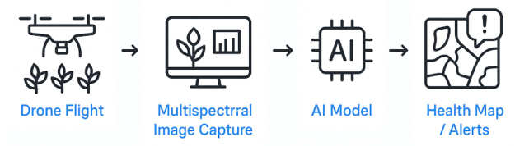
AI-based Solutions
Crop Monitoring
Monitoring Workflow
Models can run on cloud, local servers, or even onboard drone AI modules.
Health maps are overlaid on farm maps and shared via dashboards or mobile apps.

Slide 28
AI-based Solutions
Crop Monitoring
Example Use Cases
Detect nutrient deficiency before visual symptoms appear.
Locate pest hotspots for targeted treatment.
Monitor crop growth stages (e.g., flowering, ripening).
Identify irrigation leaks or overwatered areas via NDWI.
Real Deployments
KisanHub: Crop monitoring in real-time with AI-powered analytics
Skymet: Drone imagery + AI used in India for paddy field health assessment
AgEagle: Provides multispectral drone and AI solutions for large-scale farms

Slide 29
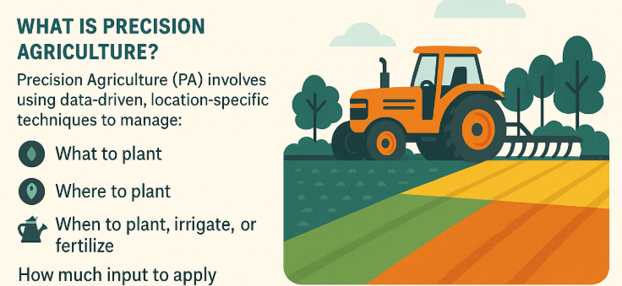
AI-based Solutions
Precision Agriculture
ML models decide where/when/how much to plant, fertilize, irrigate
Precision Agriculture with ML: How ML models guide farmers to make site-specific decisions about planting, fertilizing, and irrigating—boosting yield while reducing costs and environmental impact.
What is Precision Agriculture? Precision Agriculture (PA) involves using data-driven, location-specific techniques to manage:
What to plant
Where to plant
When to plant, irrigate, or fertilize
How much input to apply

Slide 30
AI-based Solutions
Precision Agriculture
Data Sources Used
Data Type | Description
Satellite & Drone Imagery | Vegetation indices (NDVI, GNDVI), crop stress zones
Soil Data | pH, NPK content, moisture, texture
Weather Data | Forecasts, historical climate patterns
IoT Sensors | Real-time soil and environmental data
Yield History | Field-level yield over past seasons

Slide 31
AI-based Solutions
Precision Agriculture
How ML Models Are Used
Decision | ML Technique | Output
Where to plant | Clustering (e.g., K-means) | Field zoning for crop suitability
What to plant | Classification | Predict best crop based on soil + weather
When to irrigate/fertilize | Time-Series Models (e.g., LSTM) | Optimal scheduling
How much to apply | Regression | Dose recommendation for water/fertilizer/pesticide
Yield Prediction | XGBoost / Random Forest | Estimate output based on all inputs

Slide 32
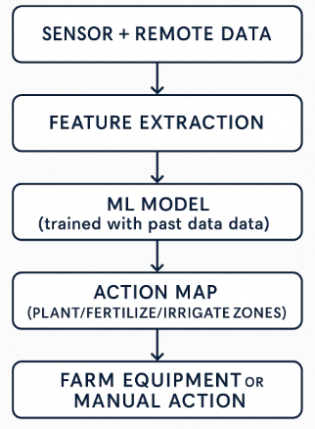
AI-based Solutions
Precision Agriculture
Example Precision Ag Workflow

Slide 33
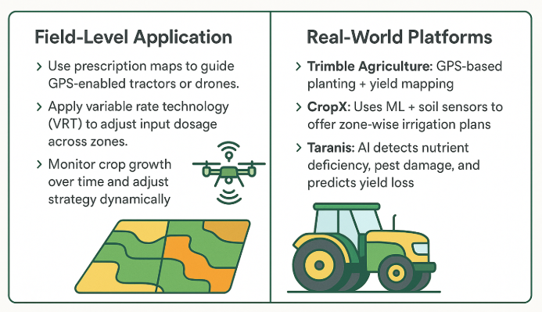
AI-based Solutions
Precision Agriculture
Field-Level Application
Use prescription maps to guide GPS-enabled tractors or drones.
Apply variable rate technology (VRT) to adjust input dosage across zones.
Monitor crop growth over time and adjust strategy dynamically.
Real-World Platforms
Trimble Agriculture: GPS-based planting + yield mapping
CropX: Uses ML + soil sensors to offer zone-wise irrigation plans
Taranis: AI detects nutrient deficiency, pest damage, and predicts yield loss

Slide 34
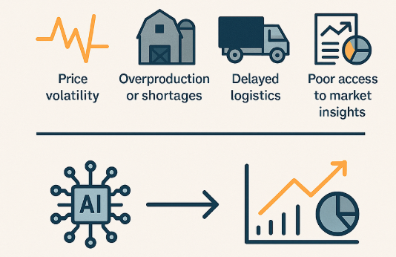
AI-based Solutions
Market Forecasting
AI systems predict demand/pricing and optimize logistics
AI for Market Forecasting in Agriculture: How AI models predict demand, pricing trends, and optimize logistics, helping farmers and agribusinesses make informed market decisions.
Why Market Forecasting Is Crucial:
Farmers and traders often suffer due to:
Price volatility
Overproduction or shortages
Delayed logistics
Poor access to market insights
AI addresses these issues with data-driven forecasting and optimization.

Slide 35
AI-based Solutions
Market Forecasting
Data Sources for Forecasting
Data Type | Description
Historical Market Prices | Commodity price trends from mandi records or eNAM
Weather Data | Impact of climate on production (e.g., monsoons → onion prices)
Crop Sowing Data | Satellite-estimated crop cover or government sowing reports
Consumer Demand | Retail demand signals, festival season trends, export/import data
Logistics Data | Transport routes, warehouse capacity, road conditions

Slide 36
AI-based Solutions
Market Forecasting
AI Techniques Used
Task | ML Model | Output
Price Prediction | Time-Series Models (ARIMA, LSTM) | Next month’s price range
Demand Forecasting | Regression / XGBoost | Future consumption estimate
Yield-Driven Price Estimation | Multi-variate regression | Impact of surplus or deficit
Supply Chain Optimization | Reinforcement Learning | Best routes, inventory plans

Slide 37
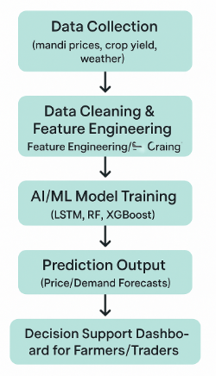
AI-based Solutions
Market Forecasting
AI Workflow for Market Forecasting

Slide 38
AI-based Solutions
Market Forecasting
Example Use Cases
Predicting tomato prices to decide when to sell
Forecasting wheat demand during export season
Optimizing transport to reduce food spoilage in perishable crops
Real-World Implementations
AgriBazaar AI Engine: Price forecasts + digital trading suggestions
IBM Watson for Agriculture: Demand-price mapping and logistics routing
eNAM (India): Integrating AI-based market advisories for farmers

Slide 39
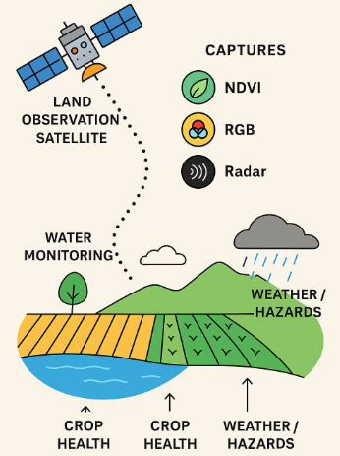
Remote Sensing
What is Remote Sensing?
Remote sensing is the science of obtaining information about objects or areas from a distance, typically using satellites or drones.
Platforms: Satellites (e.g., Landsat, Sentinel), Drones (UAVs), Aircraft
Sensors: Multispectral or hyperspectral cameras that capture light in visible, near-infrared (NIR), and shortwave infrared bands.

Slide 40
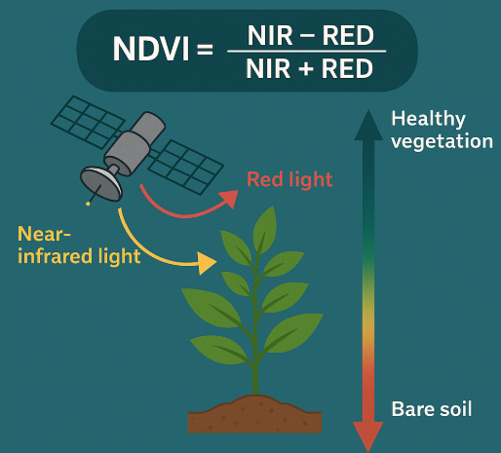
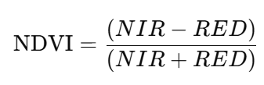
NDVI
What is NDVI?
NDVI = Normalized Difference Vegetation Index It measures the "greenness" of vegetation using reflectance values from red and near-infrared light.
NDVI Formula:
NIR (Near-Infrared): Strongly reflected by healthy vegetation
RED: Absorbed by chlorophyll in healthy vegetation

Slide 41
NDVI
NDVI Value Range & Interpretation
NDVI Value | Vegetation Status
< 0.0 | Water, Clouds, Snow
0.1–0.2 | Barren land
0.2–0.5 | Sparse vegetation or stressed crops
0.5–0.8 | Dense, healthy vegetation

Slide 42
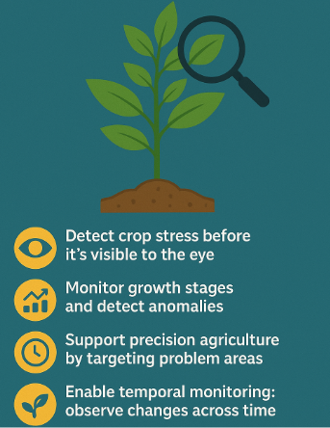
NDVI
Why NDVI is Important in Agriculture
Detect crop stress before it's visible to the eye
Monitor growth stages and detect anomalies
Support precision agriculture by targeting problem areas
Enable temporal monitoring: observe changes across time

Slide 43
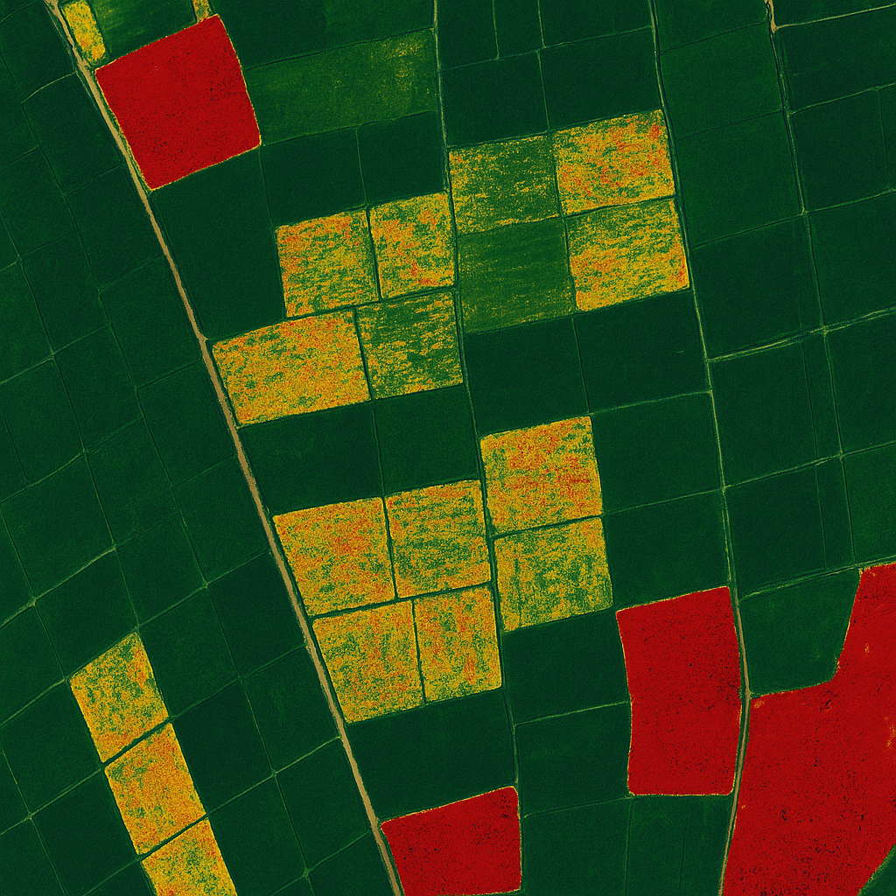
NDVI
Illustration
Dark green = healthy crops
Yellow/orange = stressed crops
Red = bare soil or dead crops

Slide 44
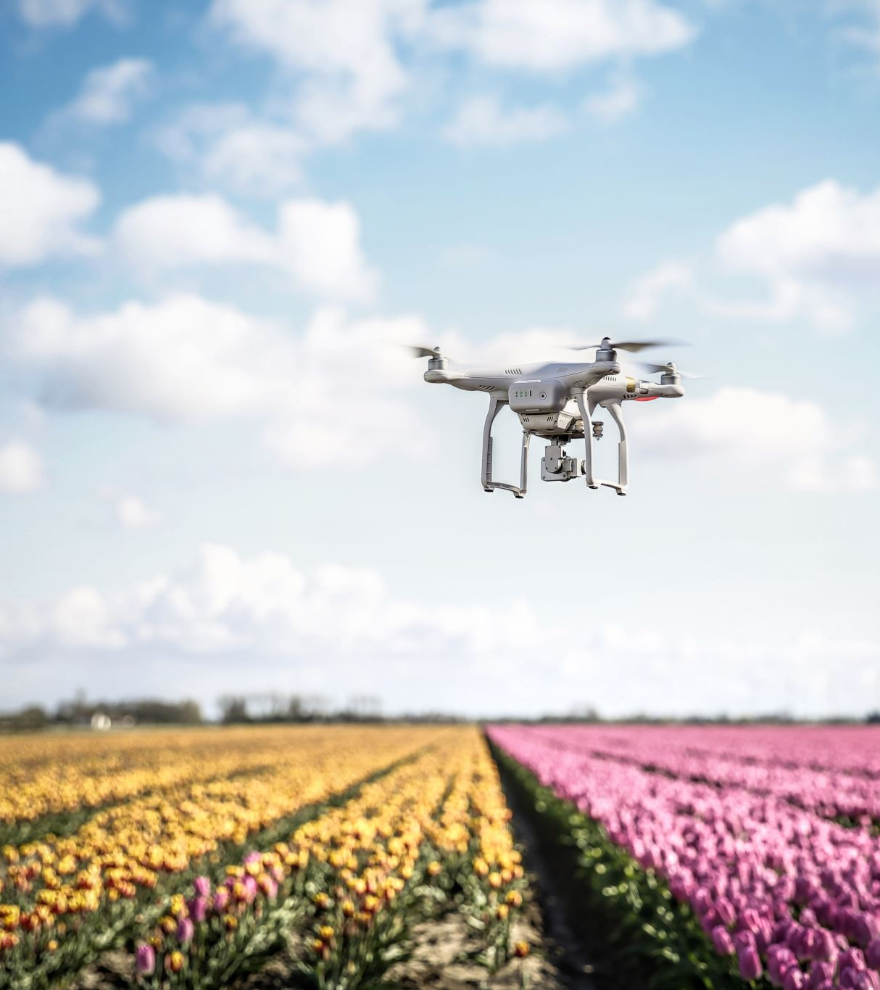
AI+Drone Vision Use Cases
Real-world applications of combining drone imagery, multispectral sensing, and AI for improving agricultural productivity.
Why Drones in Agriculture?
Drones (UAVs) provide high-resolution, real-time aerial views of farmlands. When equipped with multispectral cameras, they can:
Monitor large areas quickly
Detect problems before they’re visible
Reduce manual labor and increase monitoring frequency.

Slide 45
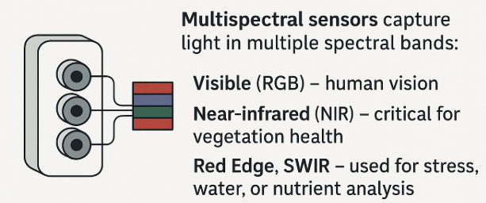
AI+Drone Vision Use Cases
What is Multispectral Data?
Multispectral sensors capture light in multiple spectral bands:
Visible (RGB) – human vision
Near-infrared (NIR) – critical for vegetation health
Red Edge, SWIR – used for stress, water, or nutrient analysis
This data is used to compute indices (e.g., NDVI) and train AI models.

Slide 46
AI+Drone Vision Use Cases
AI Applications Using Drone Imagery
Use Case | AI Technique | Outcome
Crop Health Monitoring | NDVI map + ML classification | Detect stressed areas early
Weed Detection | Image segmentation (CNNs) | Spot weeds, enable targeted spraying
Pest/Disease Detection | Object detection (YOLO, Faster R-CNN) | Identify infected plants
Yield Estimation | Regression + spatial features | Predict harvest volume
Irrigation Management | Anomaly detection in thermal maps | Detect dry or over-watered zones
Plant Counting | AI-based counting algorithms | Inventory crops or seedlings accurately

Slide 47
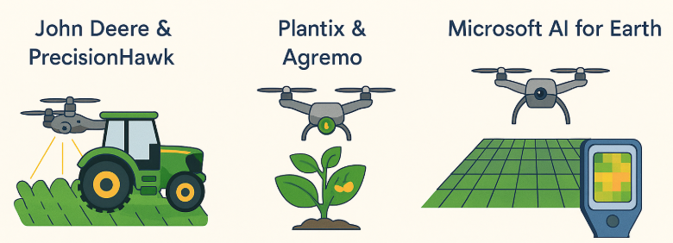
AI+Drone Vision Use Cases
Real-World Examples
John Deere & PrecisionHawk: AI-driven drone mapping for nitrogen optimization
Plantix & Agremo: Disease classification using drone-captured leaf imagery
Microsoft AI for Earth: AI + drone + NDVI for small farmers in India and Africa

Slide 48
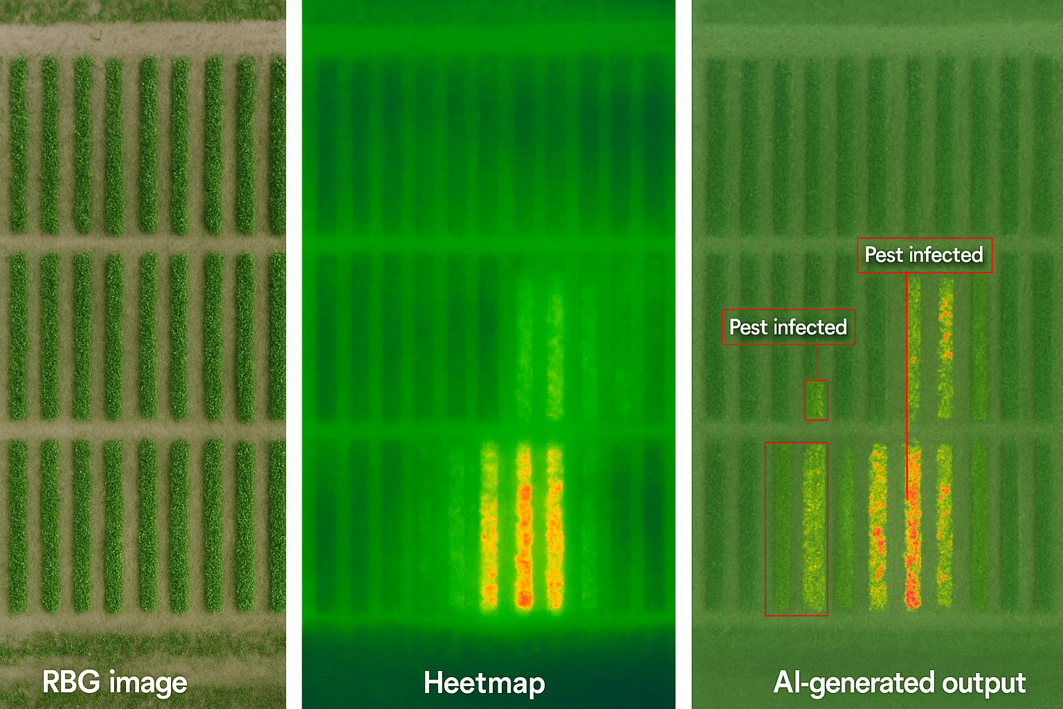
AI+Drone Vision Use Cases
Raw drone RGB image
NDVI heatmap overlay
AI-generated output (e.g., pest-infected zones highlighted)

Slide 49
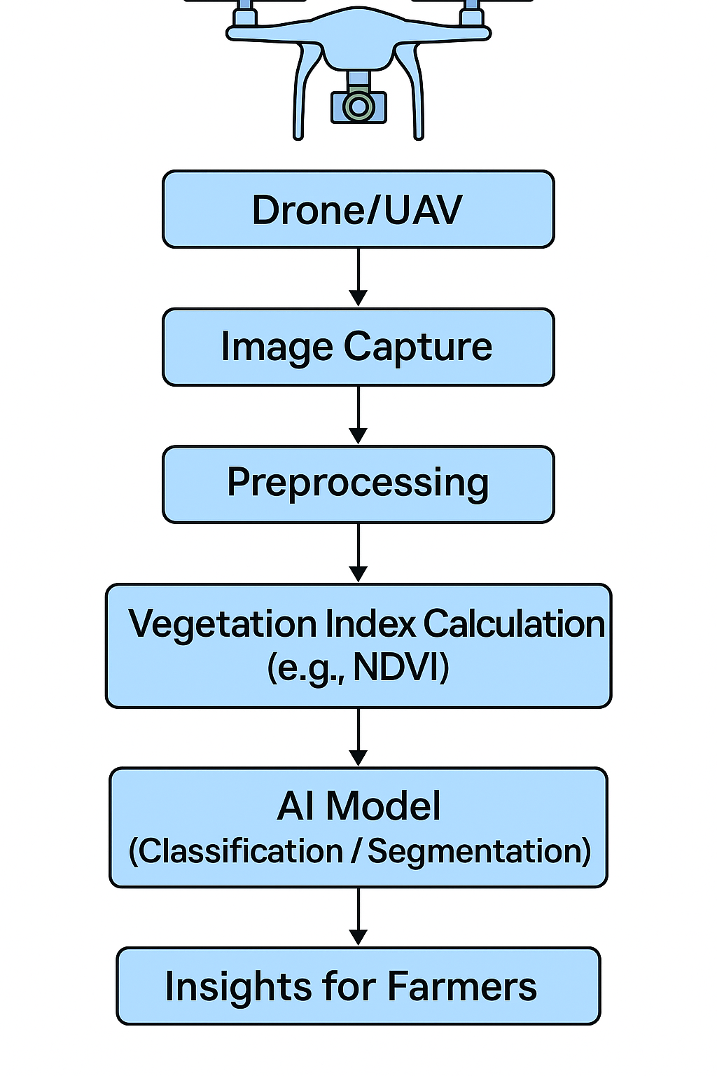
AI+Drone Vision: Architecture Overview
Pipeline Overview

Slide 50
AI+Drone Vision: Architecture Overview
Component-wise Explanation
Drone Deployment
Equipped with multispectral/thermal/RGB cameras.
Flies in a pre-defined grid or adaptive path.
Captures geotagged aerial images.
Image Capture
Resolution: Typically 10–30 cm/pixel.
Each pixel contains spectral reflectance values (e.g., red, NIR).
Captured in raw or georeferenced format (GeoTIFF, JPEG, etc.).

Slide 51
AI+Drone Vision: Architecture Overview
Preprocessing
Image stitching / mosaicking: Combines images into a single orthomosaic.
Radiometric calibration: Adjusts for sunlight/cloud interference.
Georectification: Aligns images with real-world coordinates using GPS metadata.
NDVI or Other Vegetation Index Computation
Formula: NDVI=(NIR−RED)(NIR+RED)−RED)​
Converts image into color-coded index map showing vegetation health.

Slide 52
AI+Drone Vision: Architecture Overview
AI Model (ML/DL)
Classification models: Label crop zones (e.g., healthy, diseased, dry).
Segmentation models (e.g., U-Net, DeepLab): Pixel-wise crop condition mapping.
Object detection: Count plants, detect weeds or pest infestations.
Insights for Farmers
Dashboards or mobile apps show:
Heatmaps
Alerts for stressed zones
Action recommendations (e.g., irrigate, fertilize, spray)

Slide 53
Hands-On: NDVI Analysis
Hands-On NDVI analysis: Google Earth Engine

Slide 54
THANK YOU

